Slide 1

ML 2025 Project
Authors :Truong Manh Nguyen, Thi Hien Do
Master degree in Data Science and Informatics.
Email: m.nguyen2@studenti.unipi.it, t.do1@studenti.unipi.it
Date 23/01/2005
Type of project: B

Slide 2
Objectives
Perform an extensive experimental comparison of different Machine Learning models using existing ML/NN tools.
MONK datasets(classification tasks): we compare SVM, k-NN, and Random Forest implemented within the same software tool (Scikit-learn), and Neural Network models implemented using different tools(Scikit-learn and Keras)
ML-CUP 2025 dataset (regression tasks): we compare SVM, k-NN, Random Forest, and XGBoost implemented with Scikit-learn, and Neural Network models implemented with Scikit-learn, Keras and Pytorch and apply the selected final model to the CUP blind test set.

Slide 3
Pipeline and features for the model implementation
MONK Pipeline: one-hot encoding preprocessing → model training and selection using Stratified K-Fold cross-validation (k = 3) with grid search → retraining of the best model → evaluation on the provided test set.
ML-CUP 2025 pipeline: data splitting (80% TR / 20% internal TS) → PCA preprocessing → model training and selection via K-Fold cross-validation (k = 5) with grid search → retraining of the best model - model evaluation on the internal TS → select best of best models → retrain on full training set → predict the CUP blind test set.
SVM, k-NN, RF, XGBoost models were trained using library implementations, with hyperparameters selected via grid search and evaluated under the same validation schema.
Neural Networks: we adopted architectures with one hidden layer (2–4 units for MONK), 1–2 layers for CUP, tanh or ReLU as activations, and sigmoid output for classification, linear output for regression. Training was performed using SGD or Adam optimizer with mini-batches, random weight initialization multiple run, L2 (Tikhonov) regularization, and early stopping based on validation loss, with fixed maximum epochs as stop condition

Slide 4
Monk Result: Best Hyperparameters on KNN, SVM, RF
Task | KNN | SVM | Random Forest
Monk 1 | n_neighbors: 23, metric: manhattan, weights: distance | C: 1, coef0: 0, gamma:1, degree: 2 kernel: poly | n_estimators: 50, max_depth: 7, max_features: None, min_samples_leaf: 1, min_samples_split: 2
Monk 2 | n_neighbors: 24, metric: manhattan, weights: distance | C: 10, coef0: 1, gamma:1, degree: 2 kernel: poly | n_estimators: 50, max_depth: 12, max_features: sqrt, min_samples_leaf: 1, min_samples_split: 2
Monk 3 | n_neighbors: 11, metric: manhattan, weights: distance | C: 1, coef0: 1, gamma:0.1, degree: 4 kernel: poly | n_estimators: 200, max_depth:5, max_features: None, min_samples_leaf: 1, min_samples_split: 2

Slide 5
Monk Results : KNN, RF, SVM Performances
For each best model we evaluate on test set: accuracy, classification report, confusion matrix, ROC curve
 | Accuracy(%) |  |  | Macro Avg f1-score(%) |  |  | ROC AUC(%)
Task | KNN | RF | SVM | KNN | RF | SVM | KNN | RF | SVM
Monk 1 | 80.79 | 96.30 | 100 | 80.63 | 96.29 | 100 | 91.3 | 99.7 | 100
Monk 2 | 78.94 | 72.92 | 100 | 73.68 | 69.37 | 100 | 85.3 | 82.7 | 92.8
Monk 3 | 90.97 | 97.45 | 98.61 | 90.94 | 97.45 | 98.61 | 95.1 | 99.9 | 99.9

Slide 6
Monk Results Best Hyperparameters of Neural Network
Task | Scikit Learn | Keras | Loss (TR/TS) | Accuracy (TR/TS)
Monk 1 | unit=3, act=tanh, η_init =0.05, μ=0.9, batch=16 | unit=3, act=tanh, η=0.1, μ=0.7, batch =16 | 0.0016 /0.0022 0.0032/0.0046 | 100%/100%
Monk 2 | unit=3, act=tanh, η_init=0.05, μ=0.9, batch=8 | unit=3, act=ReLU, η=0.01, μ=0.7, batch= 16 | 0.0007/0.0008 0.0363/0.0397 | 100%/100%
Monk 3 (no reg) | unit=3, act=tanh, η_init=0.05, μ=0.9, batch=8 | unit=3, act=tanh, η=0.01, μ=0.5, batch= 16 | 0.0968/0.1099 0.1331 /0.1484 | 97.54%/96.53% 95.90%/95.14%
Monk 3 reg | unit=3, act=tanh, η_init=0.005, μ=0.9, λ=0.5 batch =8 | unit=2, act=tanh, η=0.01, μ=0.5, λ=0.1, batch =16 | 0.3654/0.3414 0.340/0.3011 | 93.44%/97.22% 93.44%/97.22%

Slide 7
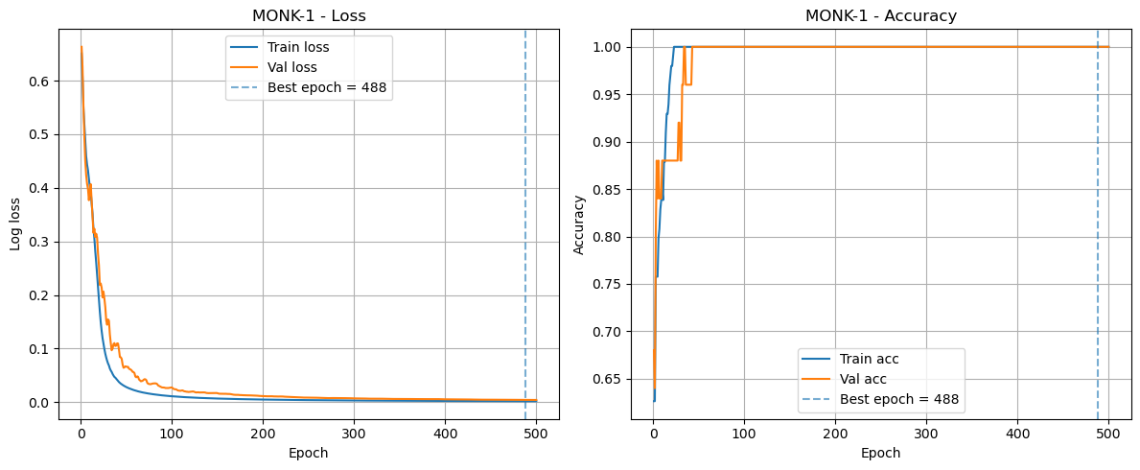
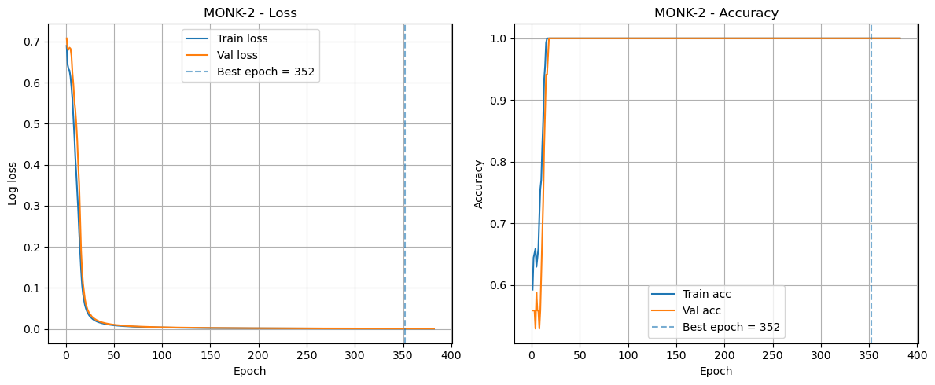
Learning curve of Monk 1 & 2

Slide 8
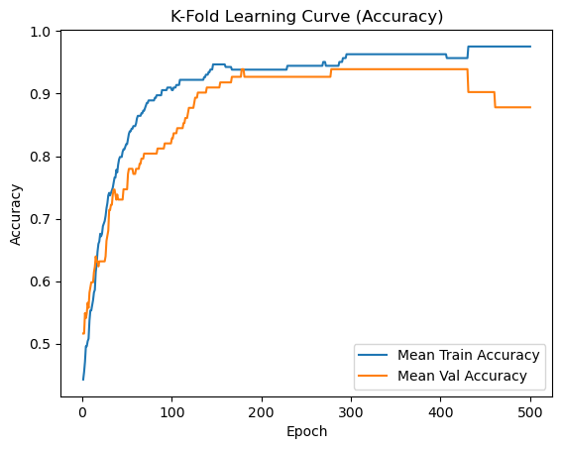
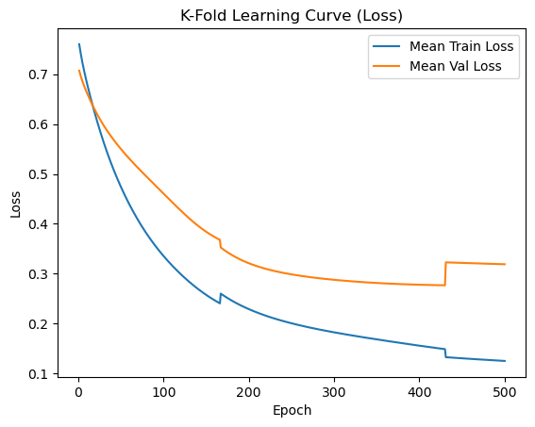
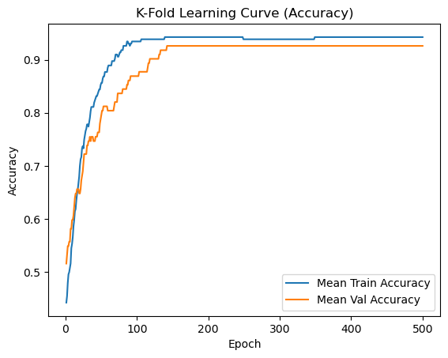
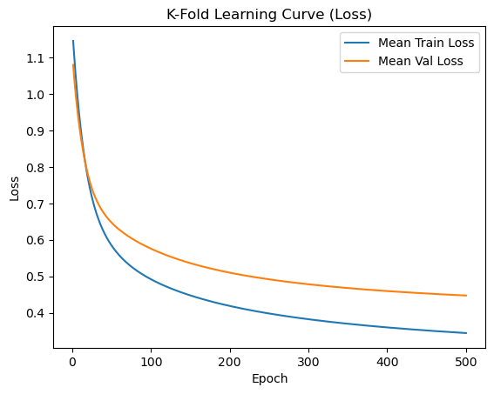
Learning curve of Monk 3 (with and without reg)

Slide 9
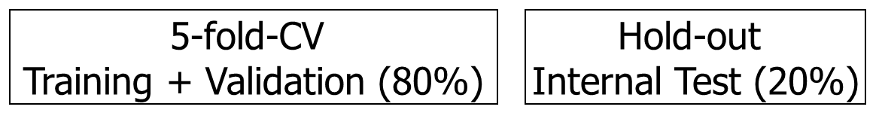
CUP Validation schema: data splitting
We split the dataset provided in TR and TS (as below). We use KFold CV for ML-Cup, with a number of folds equal to 5. We use the method from the sklearn library that allows us to shuffle the records before splitting them into folds. This approach is used for all methods from KNN, Random Forest, XGBoost, SVR, Neural Networks. Finally, we retrain the best model over the whole training set.

Slide 10
CUP Validation schema: model selection
For KNN Regressor, we use Degrees of freedom plot to choose best possible k. For SVR, Random Forest, XGBoost, we adjust each hyperparameter (such as C, gamma, epsilon for SVR) individually while keeping the others fixed. After evaluating performance through cross-validation, we select the best value for each hyperparameter. We also monitor both train MEE and test MEE to ensure there is no overfitting. These values are then used as the basis for the subsequent, more detailed grid search.
Model | Hyper parameters range
KNN | K_neighbors: (5, 7, 9, 11, 15, 21, 31, 41, 51); Knn_weights: (uniform, distance) Knn_p: (1, 2)
SVR | gamma: [0.1, 0.3, 0.37, 0.4, 0.5] C: [30, 50, 80, 120, 100, 300, 500, 1000] epsilon: [0.3, 0.6, 1.0, 1.5, 2.0, 3.0, 4.0],
Random Forest | n_estimators: [100, 200], max_depth: [3], min_samples_leaf: [1, 2, 4], max_features: [0.5, 1.0]
XGBoost | max_depth: [4, 5, 6]; n_estimators: [60, 80] min_child_weight [5, 10, 20]

Slide 11
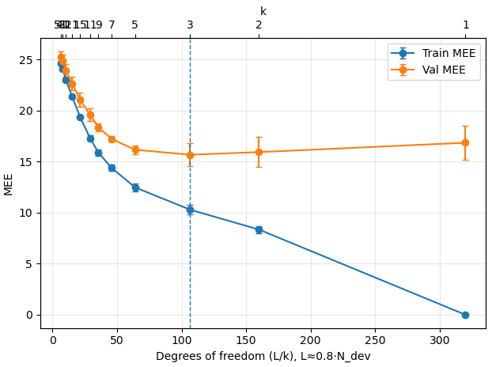
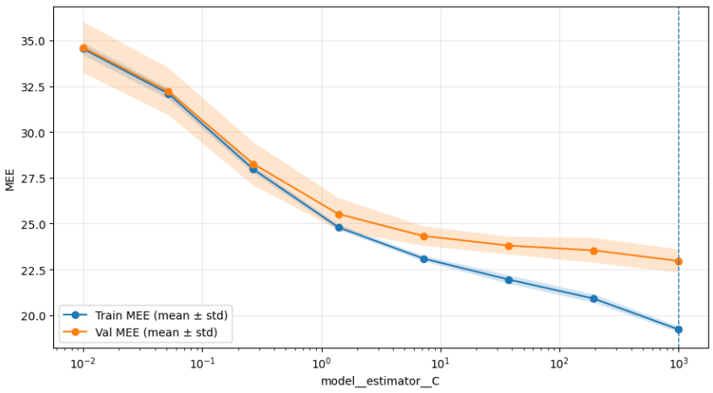
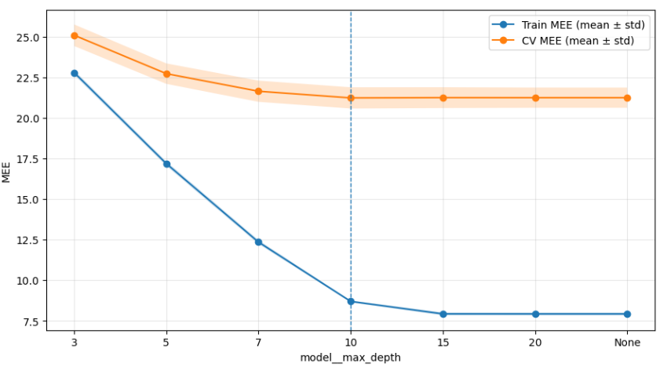
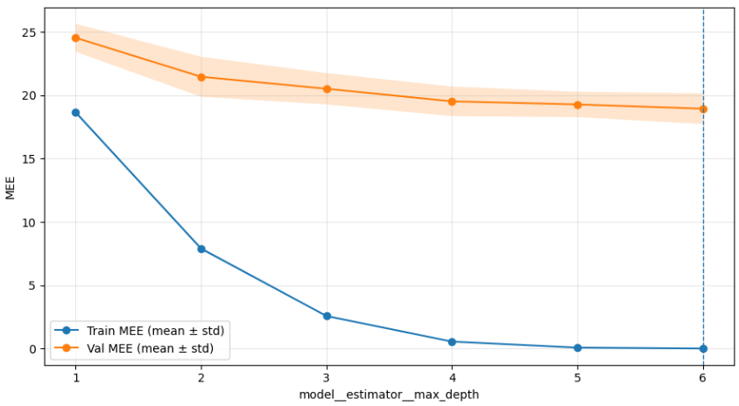
CUP Validation schema: model selection
Below are some plots to see best range of hyper parameters for each algorithm (more detail at Appendix)
KNN regressor
SVR
Random Forest regressor
XGBoost

Slide 12
CUP Validation schema: model selection
For Neural Networks, we run multiple GridSearch, keeping the number of epochs fixed at 100 to 200 (for Pytorch and Keras) and 500 for Scikit learn in order to compare results in terms of loss. With an initial set of parameters for grid search, we narrow them down after each result from the grid search to reduce running time and produce results. (For example, after multiple runs, noticing that the Adam optimizer performs better, we eliminated SGD and focused on Adam).
Library | Hyper parameters range
Scikit learn | hidden_layer_sizes: [(32,), (64,32), (32, 16), (64, 64), (128, 64)] batch_size: [128, 256], learning_rate_init: [1e-3, 2e-3, 3e-3, 5e-3], alpha: [0.01], beta_1: [0.96, 0.95, 0.99, 0.9], beta_2: [0.999, 0.9999], epsilon: [1e-8, 1e-7], activation: ["relu", "tanh"]
Py torch | hidden_layer_sizes: [(32,), (64,32), (32, 16), (64, 64), (128, 64)] batch_size: [128, 256], learning_rate: [1e-3, 2e-3, 3e-3, 5e-3], beta_1: [0.96, 0.95, 0.99, 0.9], beta_2: [0.9995, 0.9999], epsilon: [1e-8, 1e-7], activation: ["relu", "tanh"], weight_decay: [0.01, 1e-5, 1e-4, 1e-3]
Keras | hidden_layer_sizes: [(32,), (64,32), (32, 16), (64, 64), (128, 64)] batch_size: [32, 64], learning_rate: [0.01, 0.1], activation: ["relu", "tanh"], weight_decay: [0.01, 0.1]

Slide 13
CUP Results (KNN, SVR, XGBoost, Random Forest)
We identified the best-performing hyperparameter configuration for each model by gridsearch. To mitigate overfitting, hyperparameter selection was constrained to previously validated “good” regions of the search space and finalized based on cross-validated performance rather than training metrics alone.
Both KNN and SVR exhibited relatively short runtimes, primarily because KNN was optimized with a small number of neighbors, and SVR was fixed RBF kernel. For the ensemble-based models, namely XGBoost and Random Forest (RF), runtime scaled with the number of estimators (i.e., the number of trees/boosting rounds).
Model | Best hyper parameters | MEE_TR | MEE_VAL | MEE_TEST
KNN | N_neighbors: 5; p: 2; weights: distance | 0 | 15.44 | 14.38
SVR | C: 500, epsilon: 2.0, gamma: 0.5 | 13.15 | 18.22 | 18.13
XGboost | max_depth: 2, min_child_weight: 20, n_estimators: 30 | 17.95 | 22.81 | 22.04
RF | max_depth: 5, max_features: 1.0, min_samples_leaf: 1, n_estimators: 200 | 17.97 | 22.88 | 22.53

Slide 14
CUP Results (Neural Netwworks)
We evaluated SGD and Adam while training epochs are 100 for pytorchand 500 for sklearn and keras. In parallel, we compared different batch sizes and found that batch size as 128 and 32 yielded the best so subsequent experiments fixed the batch size at 128 and 32 to speed up experimentation.
After fixing the batch size, Adam consistently outperformed SGD, so the detailed evaluation phase focused on Adam. During architecture testing, the best-performing multilayer perceptron (MLP) configurations were: [32], [64, 32], [64, 64], and [128, 64]. We then narrowed the search space and concentrated the grid around these candidate architectures for fine-tuning.
For learning-curve, we fixed epochs as 500; and applied L2 regularization.
Library | Best Hyperparameters | MEE_TR | MEE_VAL | MEE_TEST
Scikit learn | hidden_layer_sizes: (128, 64), activation: 'relu', batch_size: 128, optimizer: 'adam’, lambda: 0.0001, eta_init: 0.005, beta1: 0.95, beta2: 0.9999 | 15.69 | 20.37 | 20.71
Pytorch | hidden_layer_sizes: (128, 64), activation: 'relu', batch_size: 128, optimizer: 'adam’, lambda: 0.0001, eta: 0.005, beta1: 0.95, beta2: 0.9999 | 15.41 | 20.19 | 18.57
Keras | hidden_layer_sizes: (64, 64), activation: 'relu', batch_size: 32, optimizer: 'adam’, lambda: 0.01, eta: 0.01, | 12.98 | 18.48 | 17.26

Slide 15
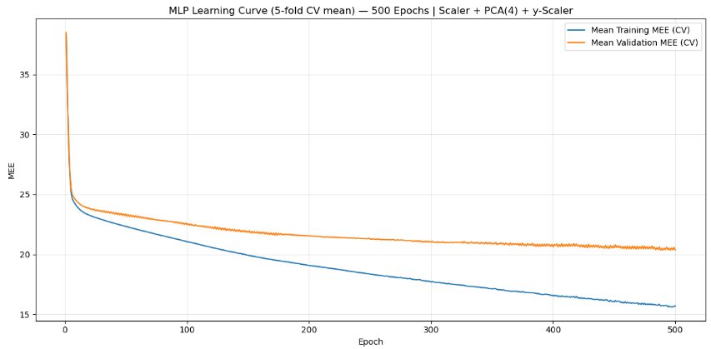
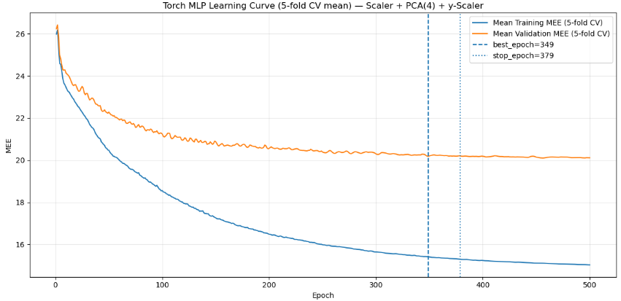
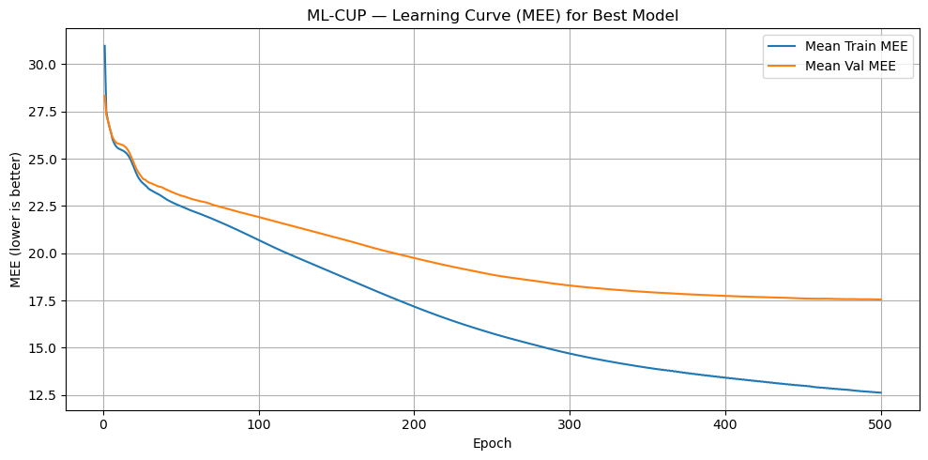
learning curve Neural networks
Scikit learn - Adam
Pytorch - Adam
Keras - Adam

Slide 16
CUP Results (best model)
Finally, we selected KNN Regressor as the best-performing model for predicting the CUP target, as it achieved the lowest internal test MEE and also provided substantially better runtime efficiency compared with all other evaluated models. Potential overfitting was assessed and mitigated using the degree-of-freedom plot, which guided the choice of model complexity and supported a better generalization trade-off.
The KNN model achieves train MEE = 0 because predictions are computed on the same training set and the best configuration uses weights="distance". For each training sample​, KNN includes the sample itself among its nearest neighbors with distance = 0, which receives a dominating weight; therefore each point will predict itselt.​
Model | Hyper parameters range
KNN | k: (5, 7, 9, 11, 15, 21, 31, 41, 51); Knn_weights: (uniform, distance); Knn_p: (1, 2)
Result | MEE_TR = 0 | MEE_VAL = 15.44 | MEE_TEST = 14.38

Slide 17
Discussion
We applied an advanced method XGBoost but did not work well for CUP because ML-CUP25 has few samples and highly correlated inputs, so boosted trees are prone to high variance/overfitting and unstable split choices.
β1 (momentum) controls how strongly Adam smooths the gradient direction: higher β1 produces smoother train/validation MEE curves.
- β2 (variance smoothing) controls how quickly Adam adapts per-parameter step sizes: higher β2 yields more stable learning curves but can slow convergence.
- Learning-curve smoothness increases with larger batch sizes because gradients have lower variance.
- PyTorch and Keras also expose learning rate directly (easier to implement modern training tricks); scikit-learn’s advantage is convenience for CV/tuning.

Slide 18
Conclusions
This project allowed us to gain a deeper understanding of the role of model selection, validation strategies, and hyperparameter tuning in Machine Learning. Through an extensive experimental comparison of classical models and neural networks, we observed that model complexity must be aligned with data characteristics, as advanced techniques do not necessarily guarantee better performance. Comparing different tools also highlighted trade-offs between training flexibility and experimental efficiency, strengthening our awareness of practical modeling decisions.
Blind Test Results:
name of the result files:Vietnamese-ML-CUP25-TS
nickname: Vietnamese

Slide 19
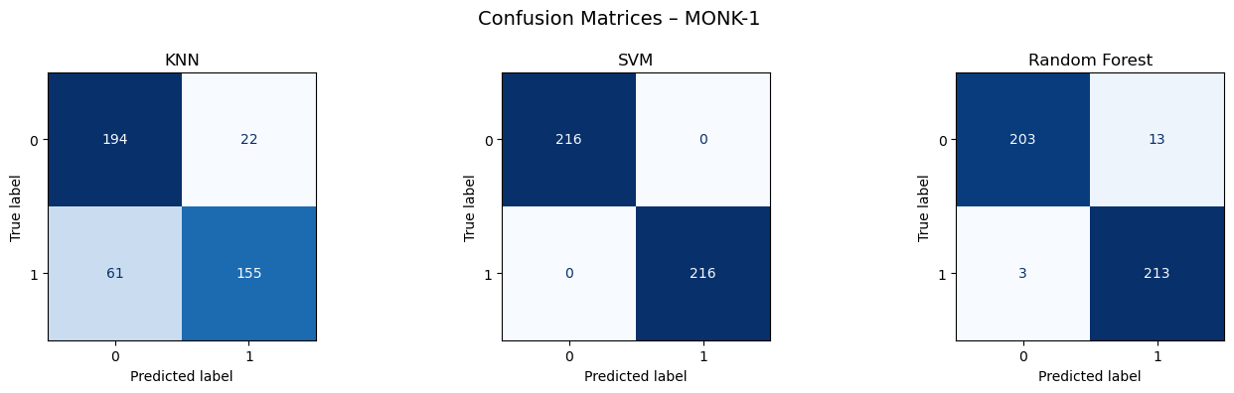
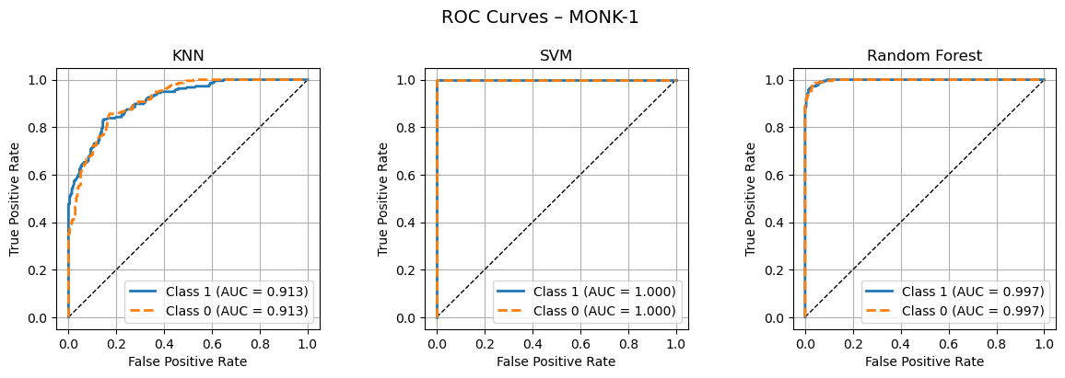
Appendix 1: Monk 1 evaluation metrics

Slide 20
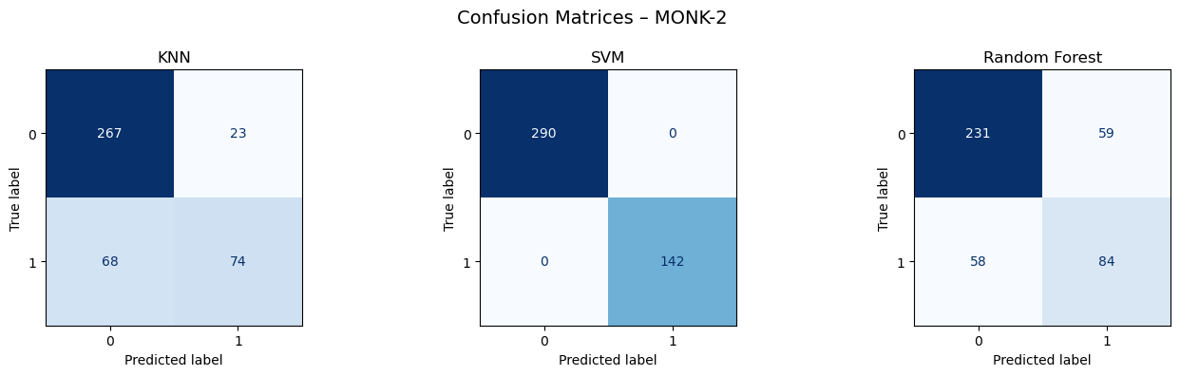
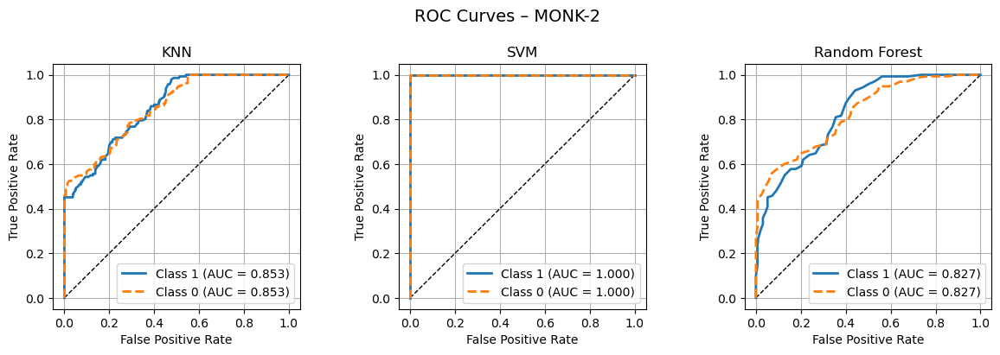
Appendix 2: Monk 2 evaluation metrics

Slide 21
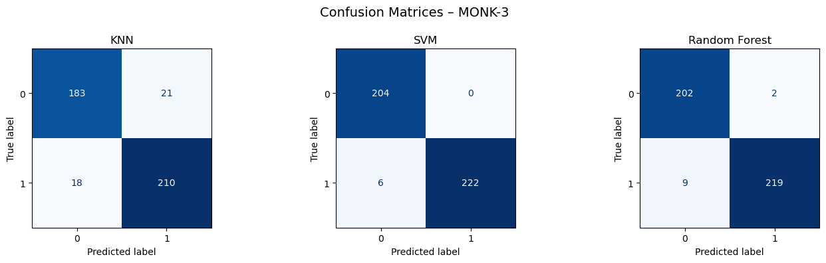
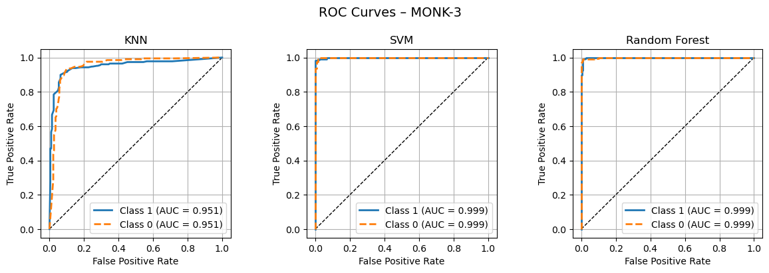
Appendix 3: Monk 3 evaluation metrics

Slide 22
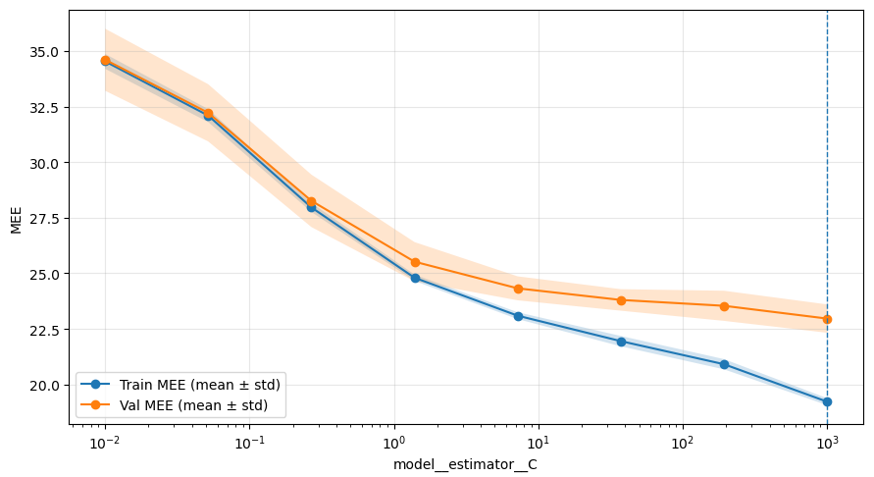
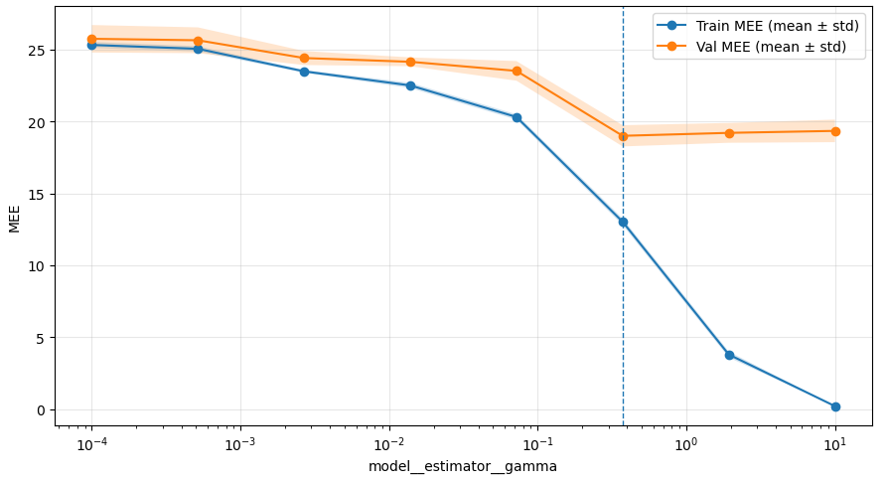
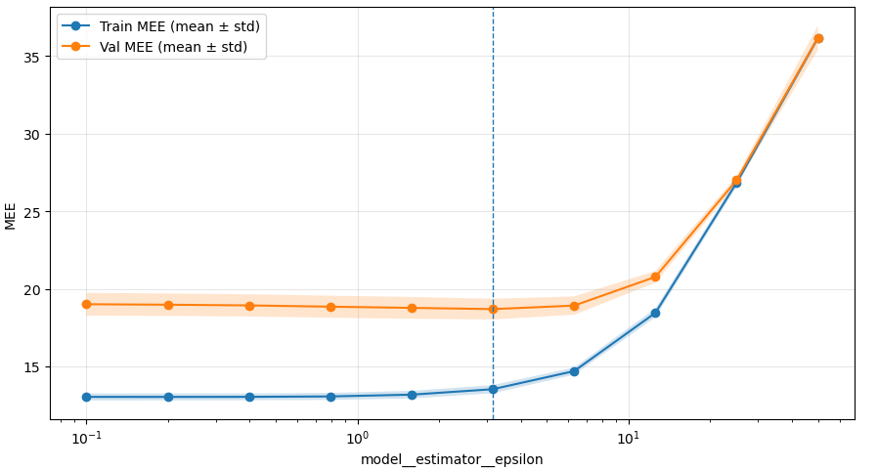
Appendix 4: SVR
Below are some plots to see best range of hyper parameters for SVR

Slide 23

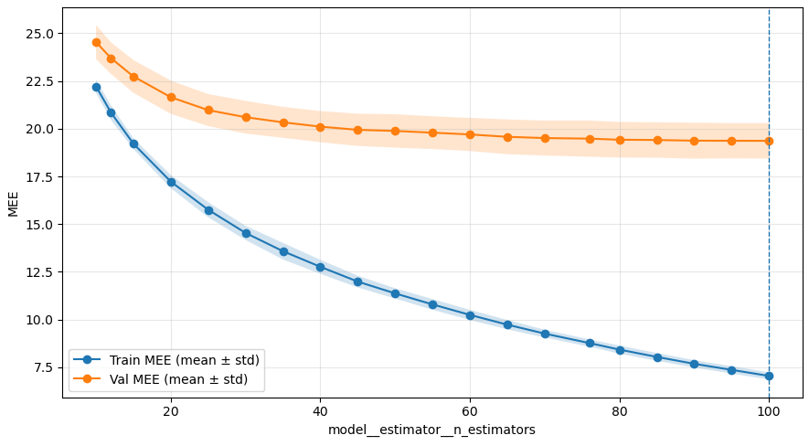
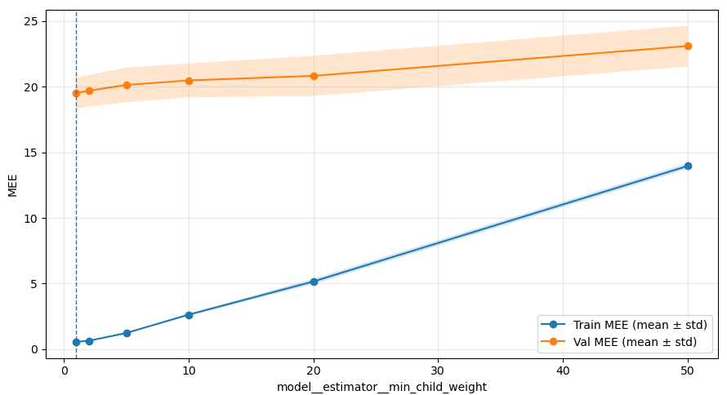
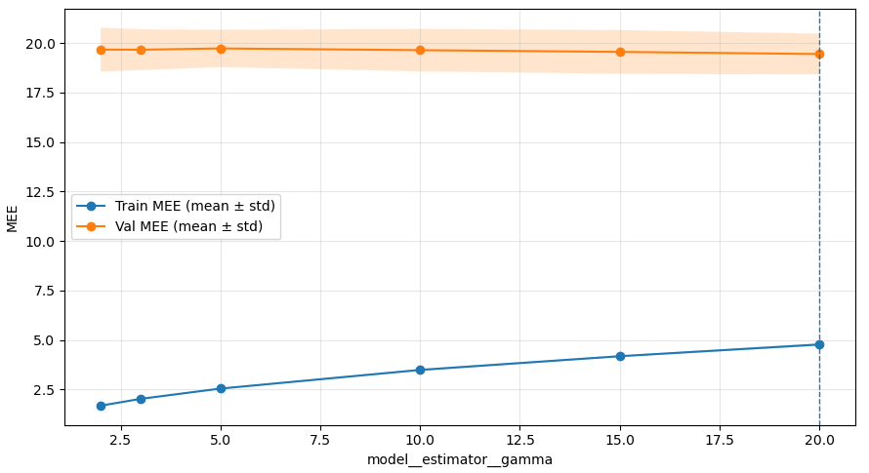
Appendix 5: XGBoost
Below are some plots to see best range of hyper parameters for XGBoost

Slide 24
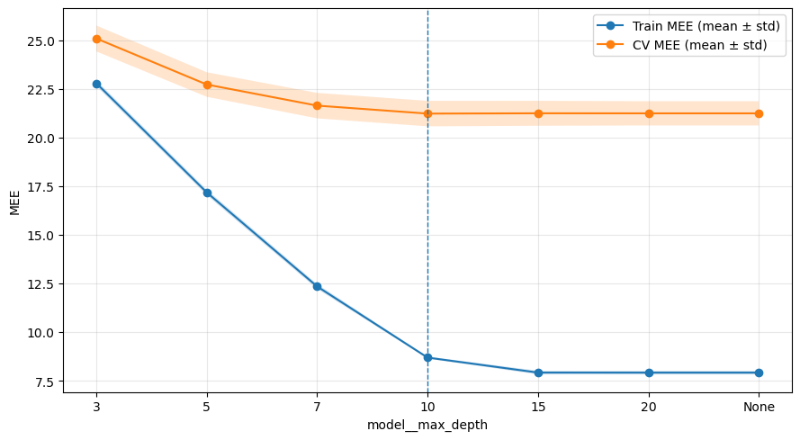
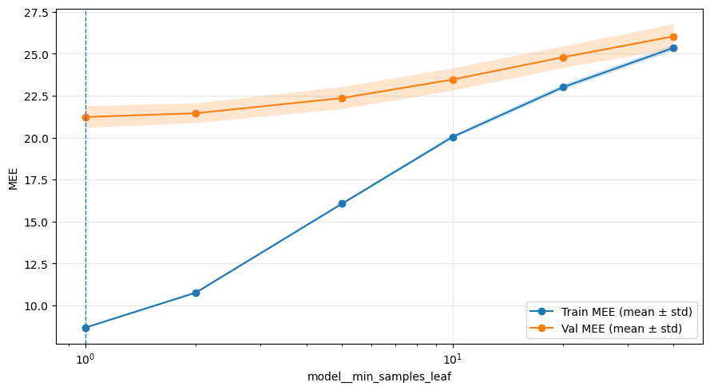
Appendix 6: Random Forest
Below are some plots to see best range of hyper parameters for Random Forest

